Slide 1
Writing a policy brief
Lecture for the 2022 FACE-IT School A *R*oundtrip from data handling to presentation
Annika E. Nilsson, Nordland Research Institute
24 November 2022 (Online)
Notes:
Cover Option 1

Slide 2
What is a policy brief?
Salience
Credibility
Legitimacy
Potential policy impact
A concise summary of key research insights
Custom-made for decision makers
Short enough to be read
Level of language that is relevant for the audience
You will produce a policy brief of 2 or 4 pages!

Slide 3
Planning a policy brief
Why produce a policy brief?
Who is your audience?
What impact would you want?
Why would they want to read it?
What policy process is relevant? What part of the process?
What do you want to communicate?

Slide 4

What type of policy context?
Local planning
…
National legislation
International
Regional collaboration
Natural resource management
Biodiversity Convention?
Climate Convention?
UNCLOS?
IMO?
Arctic Council processes?
Fisheries policies?
EU?

Slide 5
A policy process: Where do your insights fit?
Agenda setting
Policy formulation
Policy adoption
Implementation
Evaluation
A new concern?
Scale of problem
Convincing legislators
Education and stakeholder support
Monitoring of policy impacts
Possible solutions
Supporting evidence

Slide 6
Your audience
How do your knowledge and data fit?
What is your intended audience interested in?
Background information for problem definition or policy formulation?
Specific data to support political decisions
Understanding the consequences of specific decisions?
Monitoring and follow-up of earlier decisions
How are decision makers likely to use your information?
How much time do they have?
What background knowledge do they have?
How can you shape your policy brief to make sure it is read and understood?

Slide 7
The policy brief
Title: Informative and policy relevant
Key messages
Background/problem context
Your results and how you obtained them
Figures and figure legends to present data
Infographics to explain processes and connections
Maps
Words:
Subheadings
Running text
Boxes
Connecting your data to the policy context: What are the implications?
Policy options (without being policy prescriptive)
Key references
Author, publisher, date, ISBN/DOI/link

Slide 8
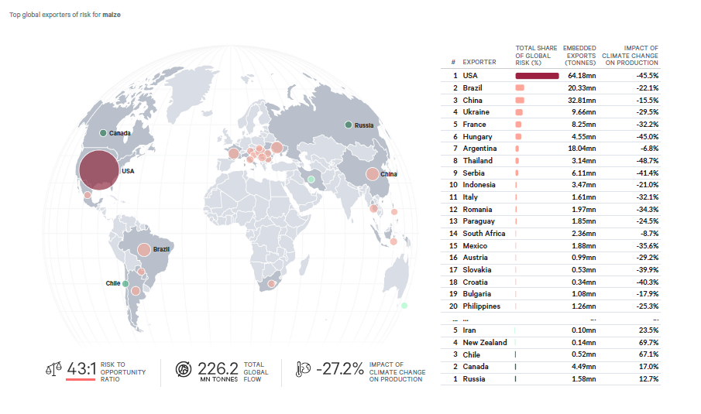
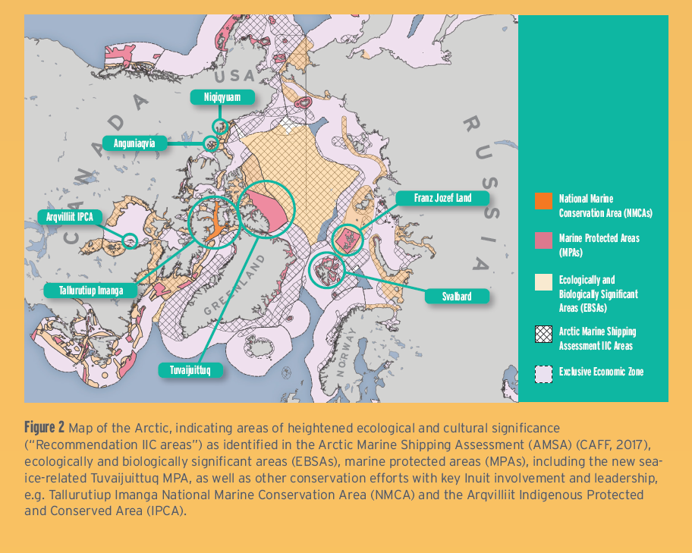

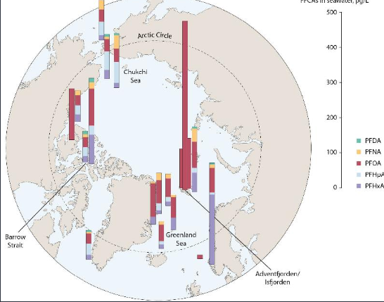

Maps
.
https://www.amap.no/maps-and-graphics

Slide 9
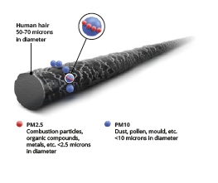
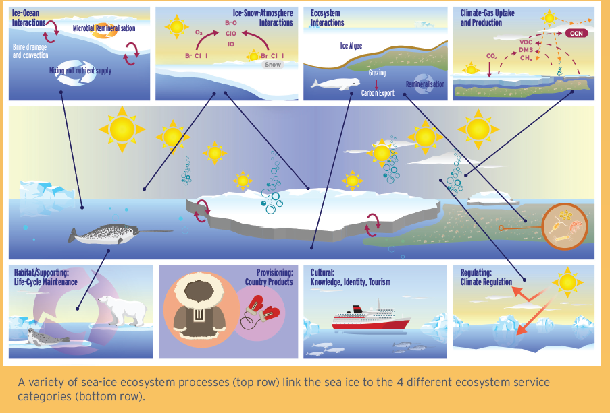

Infographics
.

Slide 10
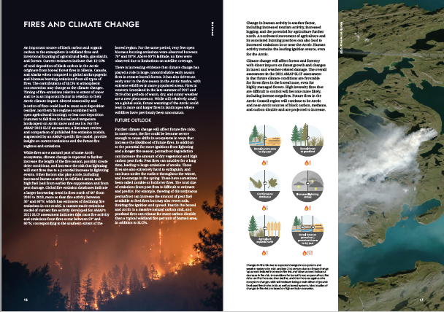
Layout: Combining the elements on a page
.

Slide 11
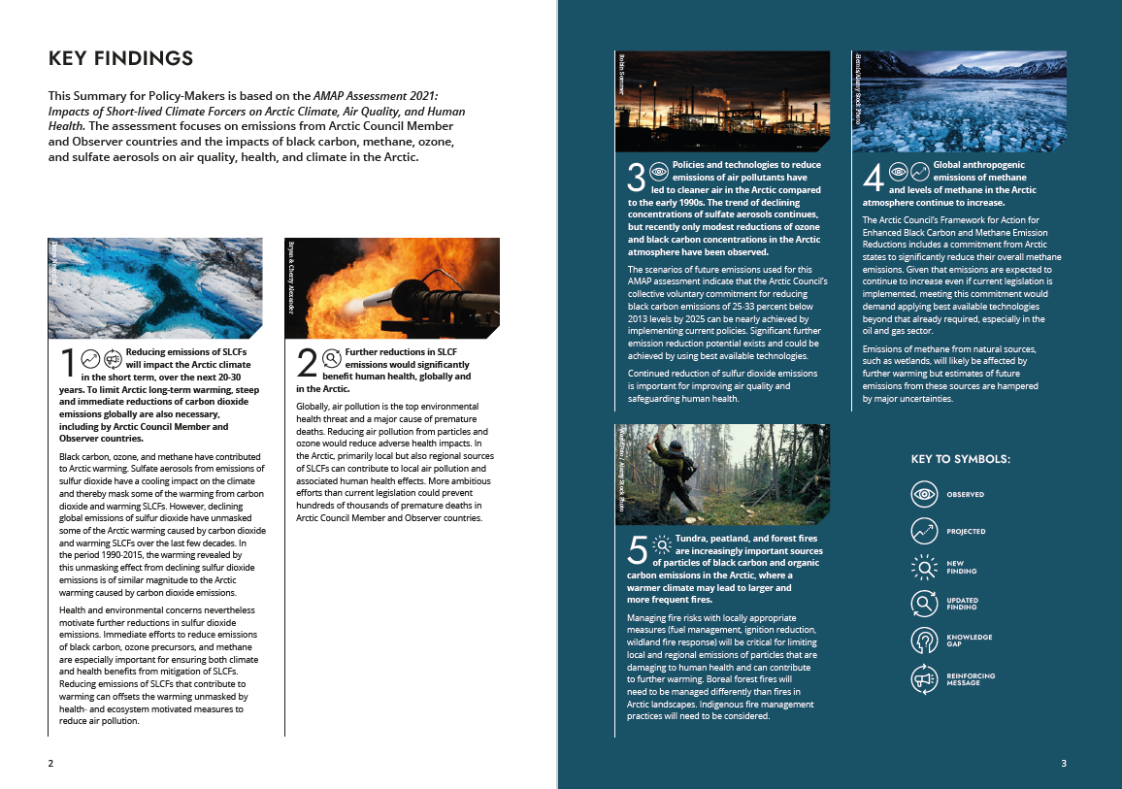

Slide 12
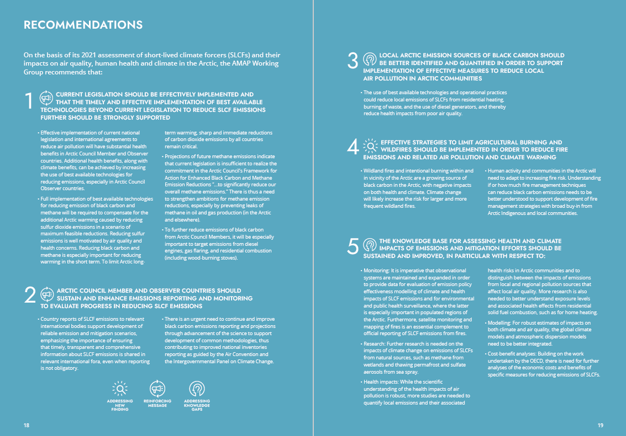
.

Slide 13
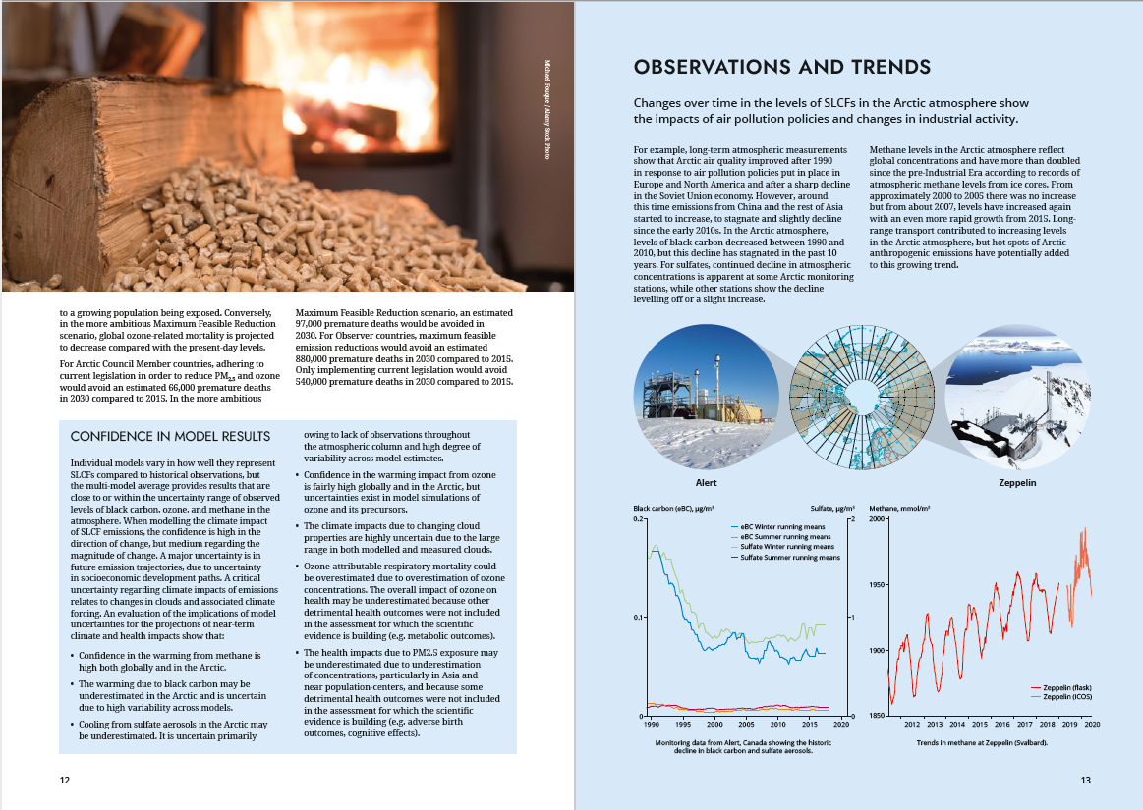

Slide 14
What to do now . . .
Select a topic for your policy brief
Something you know about, if possible based on your own or FACE-IT research and data
Decide on the audience and the main messages you want to communicate
Select the main elements you want to include (text, data, other graphical elements)
Make a mock layout to see how much you can fit into your policy brief
A4 format and FACE-IT’s graphical profile; 2 or 4 pages
Write a draft version of the text
Produce draft figures/graphics
Combine the elements into your mock layout to see if they fit and are possibile to read
Revise text, graphics and layout until you are reasonably happy
Ask your course colleagues to act as a proxy for your audience and provide feedback
Revise . . .

Slide 15




STAYING IN TOUCH
annika.nilsson@vetani.se
www.face-it-project.eu
@FACEITArctic
@FACEITArctic
@face_it_arctic
@The FACE-IT Project

